Slide 1
Plato & Aristotle on art Dr. Stephanie Spoto sspoto@mpc.edu Monterey Peninsula College
Gentrain
6 November 2018

Slide 2
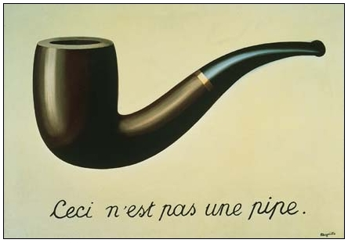
Mimesis
Magritte's "La Trahison des Images" ("The Treachery of Images") (1928-9) or "Ceci n'est pas une pipe" ("This is not a pipe"). Sometimes translated as "The Betrayal of Images" By René Magritte, 1898-1967. The work is now owned by and exhibited at LACMA.
μίμησις mimesis
A broad philosophical term: imitation, representation, mimicry, the act of resembling, the act of expression, and the presentation of the self
Hellenistic usage → idea that governed the creation of works of art, especially in relation to the physical world (ideal model of beauty, good, truth)

Slide 3
Plato’s concept of Mimesis Ion
Ion: poetry is the art of divine madness, or inspiration.
The poet is under the influence of this divine madness → cannot possessing "art" or "knowledge" – techne – of the subject (532c)
Does not speak truth (as characterized by Plato's account of the Forms).
Only philosophers concerned with truth.
Oral culture (attacks theatre rather than written word): Plato critiques theatre as being insufficient in conveying the truth (540c).
Actors, poets, and orators (Sophists) able to persuade an audience by rhetoric rather than by telling the truth (535b).

Slide 4
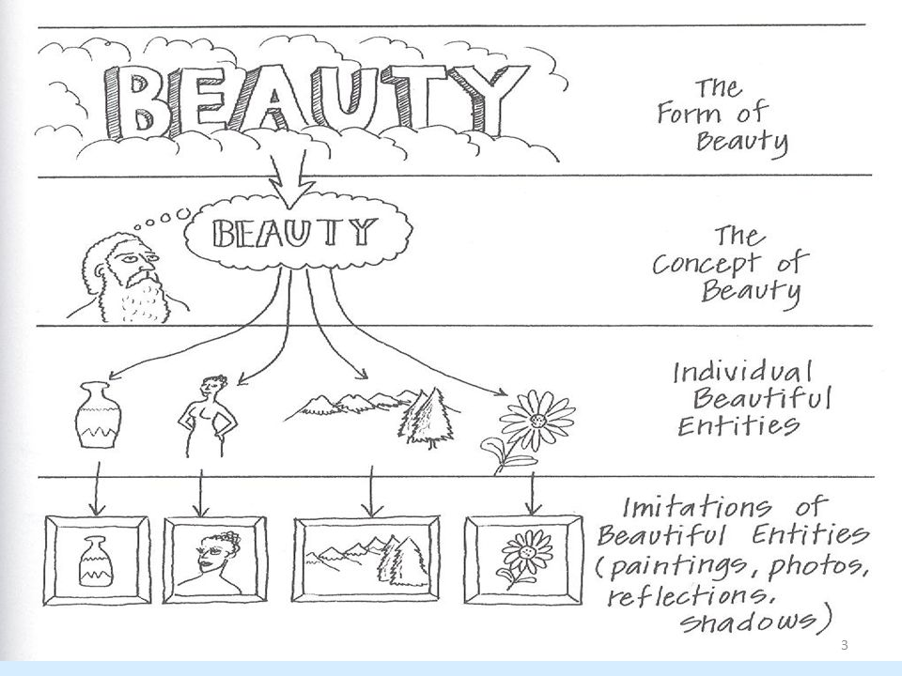

Slide 5
Plato: Art as Imitation Epistemological concerns The Republic (Books II, III, and X)
Socrates in dialogue with students: Poetry cannot attain truth; those who listen to poetry should be ‘on guard’ against its allures and seduction → poet has no place in our idea of God. (Book II)
Metaphor of 3 beds: Socrates tells of three beds
First bed: idea from God; form or Platonic ideal
Second bed: crafted by carpenter; imitation of original form (God’s idea)
Third bed: Artist’s painting/representation of bed; imitation of the carpenters
“Then if he does not make that which exists he cannot make true existence, but only some semblance of existence; and if any one were to say that the work of the maker of the bed, or of any other workman, has real existence, he could hardly be supposed to be speaking the truth” (Republic, Book X)

Slide 6
Plato: Art as Imitation Epistemological concerns The Republic (Books II, III, and X)
Artist’s painting of bed is twice removed from truth
Copy of the carpenters which is crafted on ideal
Bed appears different from different angles → artists can only represent points of view, and are ignorant of the mechanics of the bed (a chair is also used to demonstrate this point).
Even skilled artists are mere imitators who will never attain the truth of God’s creation.
“I mean, that you may look at a bed from different points of view, obliquely or directly or from any other point of view, and the bed will appear different, but there is no difference in reality. And the same of all things” (Republic, Book X).

Slide 7
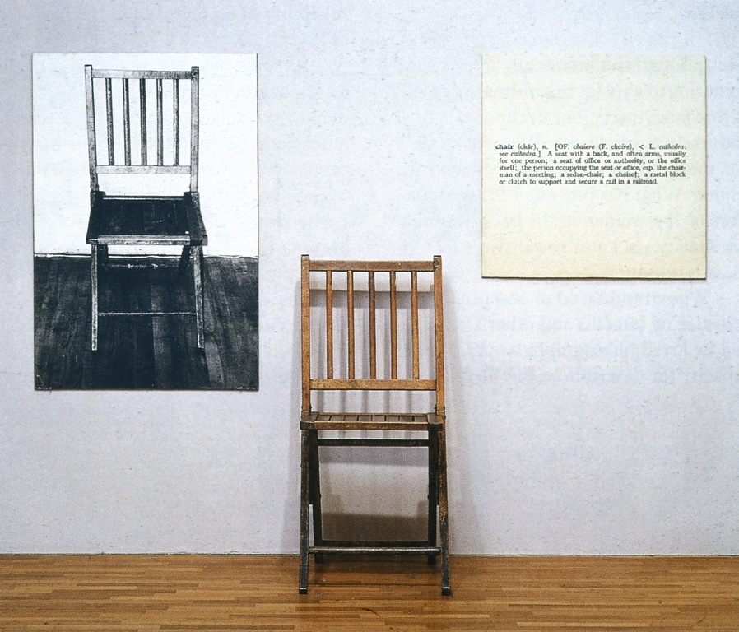
Joseph Kosuth (American, b. 1945)
One and Three Chairs
Musee National d’Art Moderne, Centre Georges Pompidou, Paris, France

Slide 8
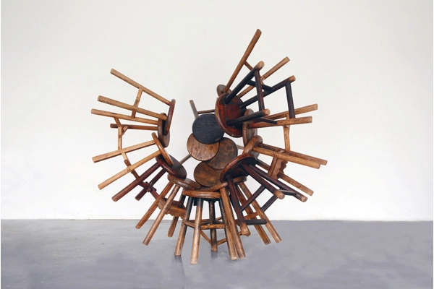
Ai Weiwei
2007 17 wooden Qing Dynasty (1644-1911) stools 166.5 x 177.5 x 154 cm (65 1/2 x 69 7/8 x 60 5/8 in.) Signed and dated 'Ai Wei 2007' on the underside.

Slide 9
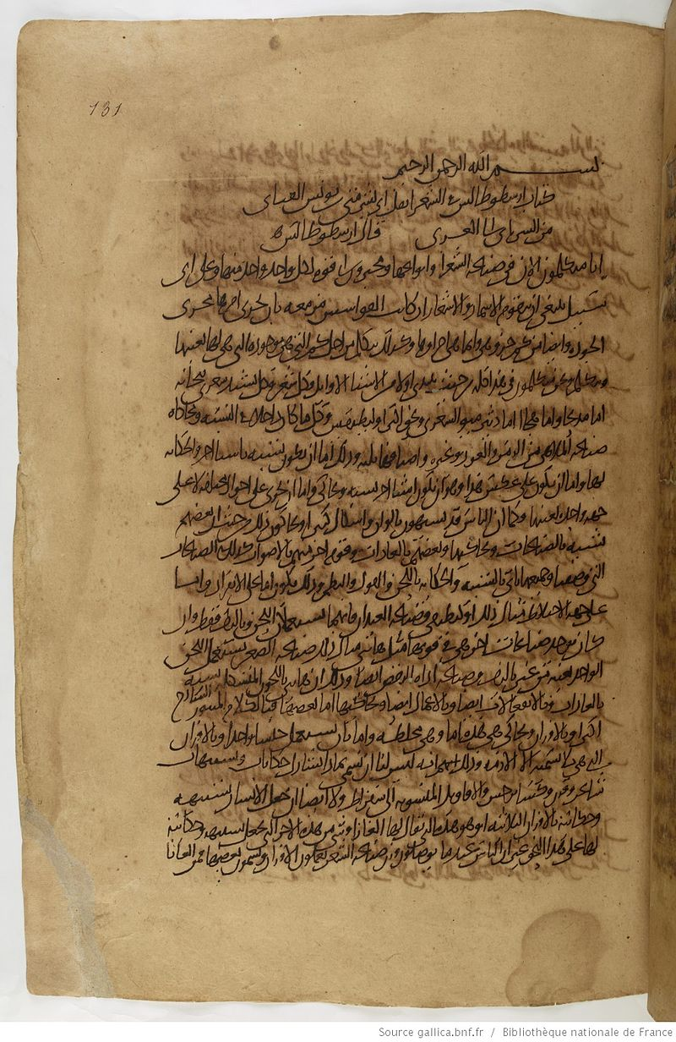
Aristotle’s idea of Mimesis Poetics c. 335 BCE
Mimesis the perfection, imitation of nature
But also makes use of mathematical ideas (like symmetry) to seek out/understand the timeless, eternal, the good, and the perfect.
Aristotle’s Poetics → earliest existing work on dramatic and poetic theory
Greek poema "fiction, poetical work," literally "thing made or created," early variant of poiema, from poein, poiein, "to make or compose"
Aristotle was not against art or poetry → people are naturally memetic and desire to create works/texts/art
Argues that poetry is a better teacher than history
History deals with what happened
Literature/poetry deals with what could have taken place, or what should have taken place
Arabic translation of the Poetics by. Abū Bishr Mattā,
b. 970 CE.

Slide 10
Aristotle on Catharsis
Must be distance between art and life → audience draws knowledge & consolation from tragedies because they are not our own lives
This distance between viewer/spectator and art/actors is necessary for catharsis
catharsis meaning "purification" or "cleansing") is the purification and purging of emotions—especially fear and pity—through art → an extreme alteration/shift that results in purification and restoration
There must be a balance between identification and distance (audience must relate to characters/story in order to be ‘touched’ by story).

Slide 11
Aristotle on Tragedy & Catharsis Poetics c. 335 BCE
Aristotle: Tragedy can be an impactful educational tool → successful tragedies produce catharsis
Tragedy is the performance/mimesis of certain people or actions
Through “simulated representation” or mimesis that catharsis becomes possible → acting on stage conveys what the characters feel creating the opportunity for empathy through dramatic mimetic form.
Dramatist’s task: produce the tragic mimetic form in order to create opportunity for empathy via relationship/distance of audience and characters
Both recognizable and distant:
In short, catharsis can only be achieved if we see something that is both recognizable and distant.

Slide 12
Next session
Group discussion – Thursday 8:45-9:40am
Exam – Thursday 9:50-10:50am

